Slide 1
Nigeria COVID-19 Data Analysis using Python
Dahiru Ibrahim Dahiru

Slide 2
Table of contents
01
02
03
Project Introduction
Data Overview and Extraction
Data Cleaning
04
05
Visualization and Insights
Conclusion
Includes summary and problem statement.
In-depth description of the data and its extraction.
Includes methods used to process the data.
Includes charts and discussions.
Results and conclusion.

Slide 3
01
Introduction

Slide 4
Coronavirus disease (COVID-19) is an infectious disease caused by the SARS-CoV-2 virus.
With its great tendency to spread, Nigeria became a safe haven for it. Ever since the confirmation of the first case in Nigeria on 27th of February, 2020, the trajectory of cases has only seen a steady rise.
This project investigates COVID-19’s stay in Nigeria; exploring its effects on the economy and health sector among others. The solution will also be stated.

Slide 5
02
Data Overview and Extraction

Slide 6
Data Sources
NCDC Dataset
Nigeria GDP Data
John Hopkins GitHub Data Repo
WHO Vaccination Data
Nigeria Budget Data
Nigeria COVID Vulnerability Index

Slide 7
Data Overview
NCDC Dataset | No. of Confirmed Cases
 | No. of Admitted Cases
 | No. of Discharged Cases
 | No. of Deaths
Nigeria COVID Vulner-ability Index | Overall CCVI Index
 | Epidemiological
 | Fragility
 | Health System
 | Population Density
 | Socio-Economic
 | Transport Availability
 | Acute IHR
 | Region
 | Population
Nigeria Budget Data | 2014 Q1 – Q4
 | 2015 Q1 – Q4
 | 2016 Q1 – Q4
 | 2017 Q1 – Q4
 | 2018 Q1 – Q4
 | 2019 Q1 – Q4
 | 2020 Q1 – Q4
Josh Hopkins Global Data | Global Daily Confirmed Cases
 | Global Daily Recovered Cases
 | Global Daily Death Cases
WHO Vaccination Data | Daily Vaccinations
Nigeria GDP Data | Initial Budget
 | Revised Budget

Slide 8
03
Data Cleaning

Slide 9
Data Cleaning
Cleaning NCDC Data involved:
Renaming columns to a more appropriate description
Removing ‘coma’ from numerical columns like No. of Cases (Lab Confirmed)
Conversion of columns to the appropriate datatype
Cleaning Josh Hopkins Global Data involved:
Selecting only the data point for Nigeria
Dropping ‘Province/State’, ‘Country/Region’, ‘Lat’ and ‘Long’ columns

Slide 10
04
Visualization and Insights

Slide 11
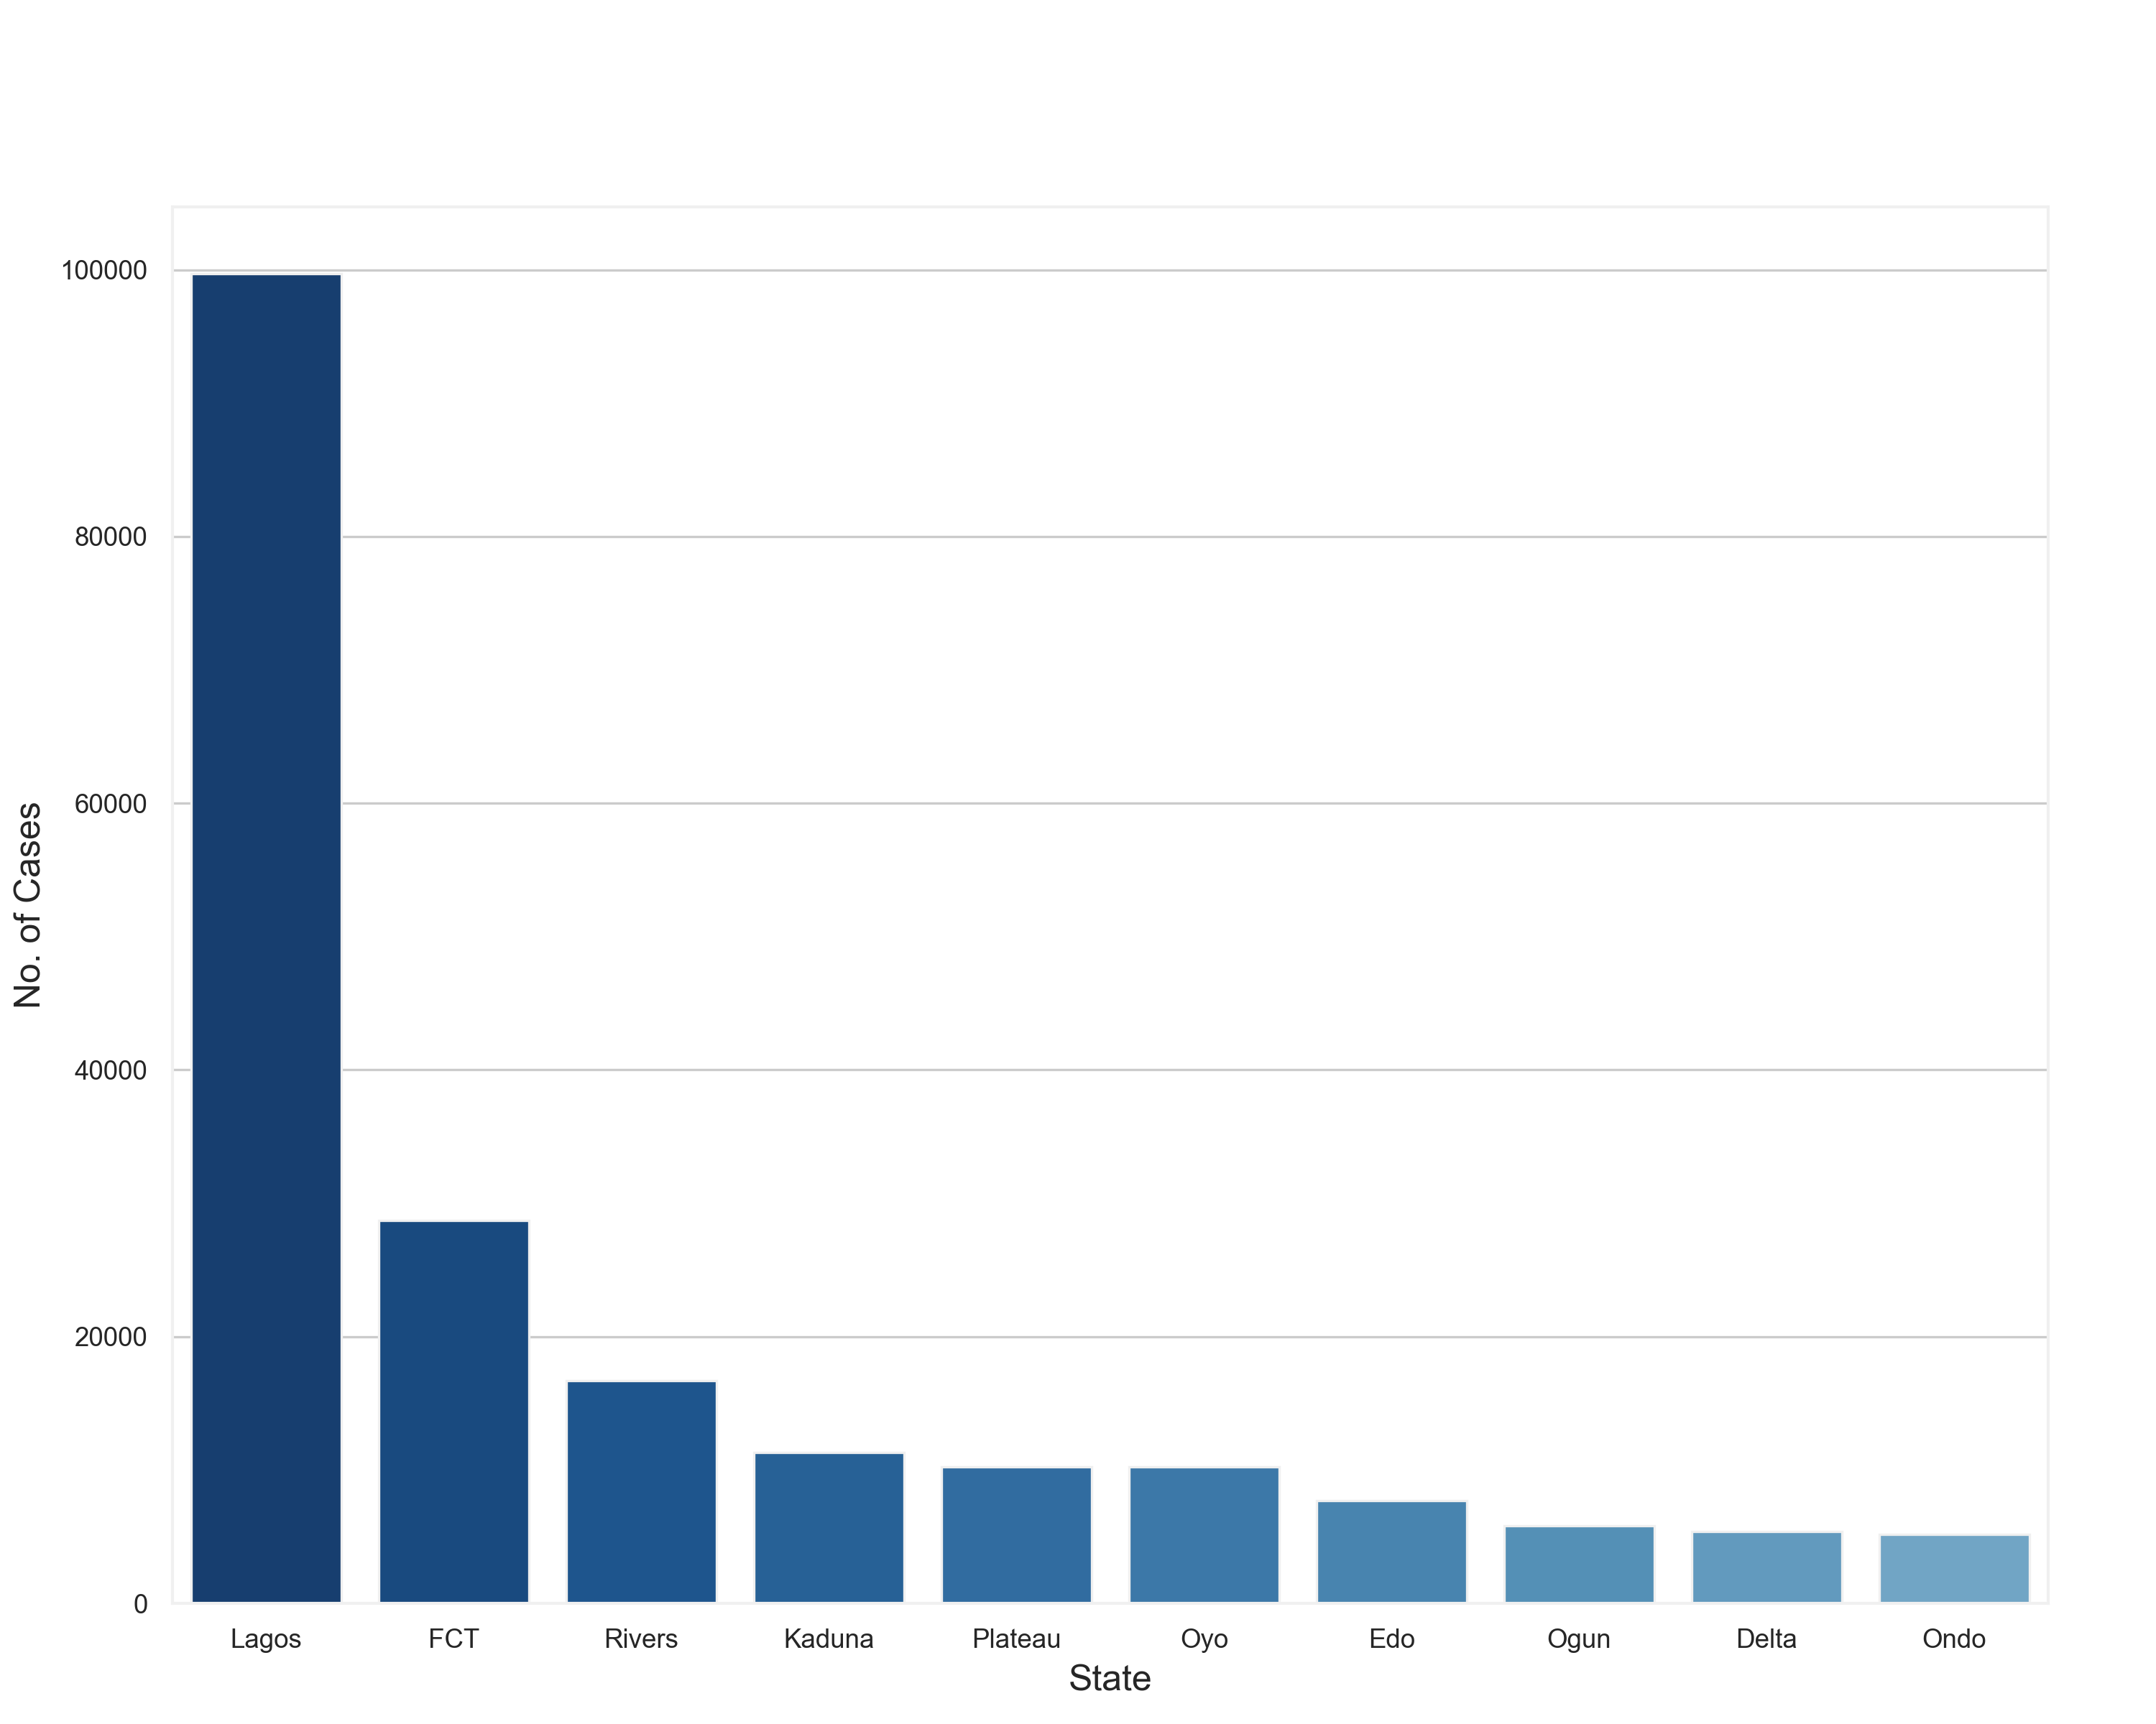
States with Highest Confirmed Cases
This plot shows that Lagos is by far the state with the highest number of confirmed cases.

Slide 12

States with Highest Discharged Cases
This plot shows that Lagos also records the highest number of discharged COVID patients.

Slide 13
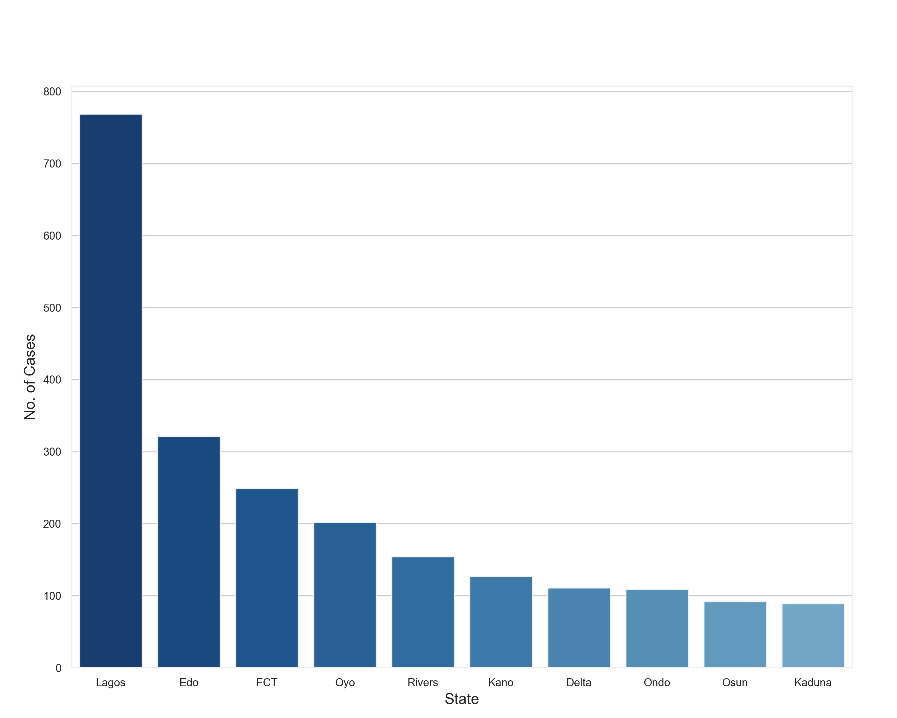
States with Highest Death Cases
This plot tells us how Lagos also records the highest number of deaths attributed to COVID 19.

Slide 14
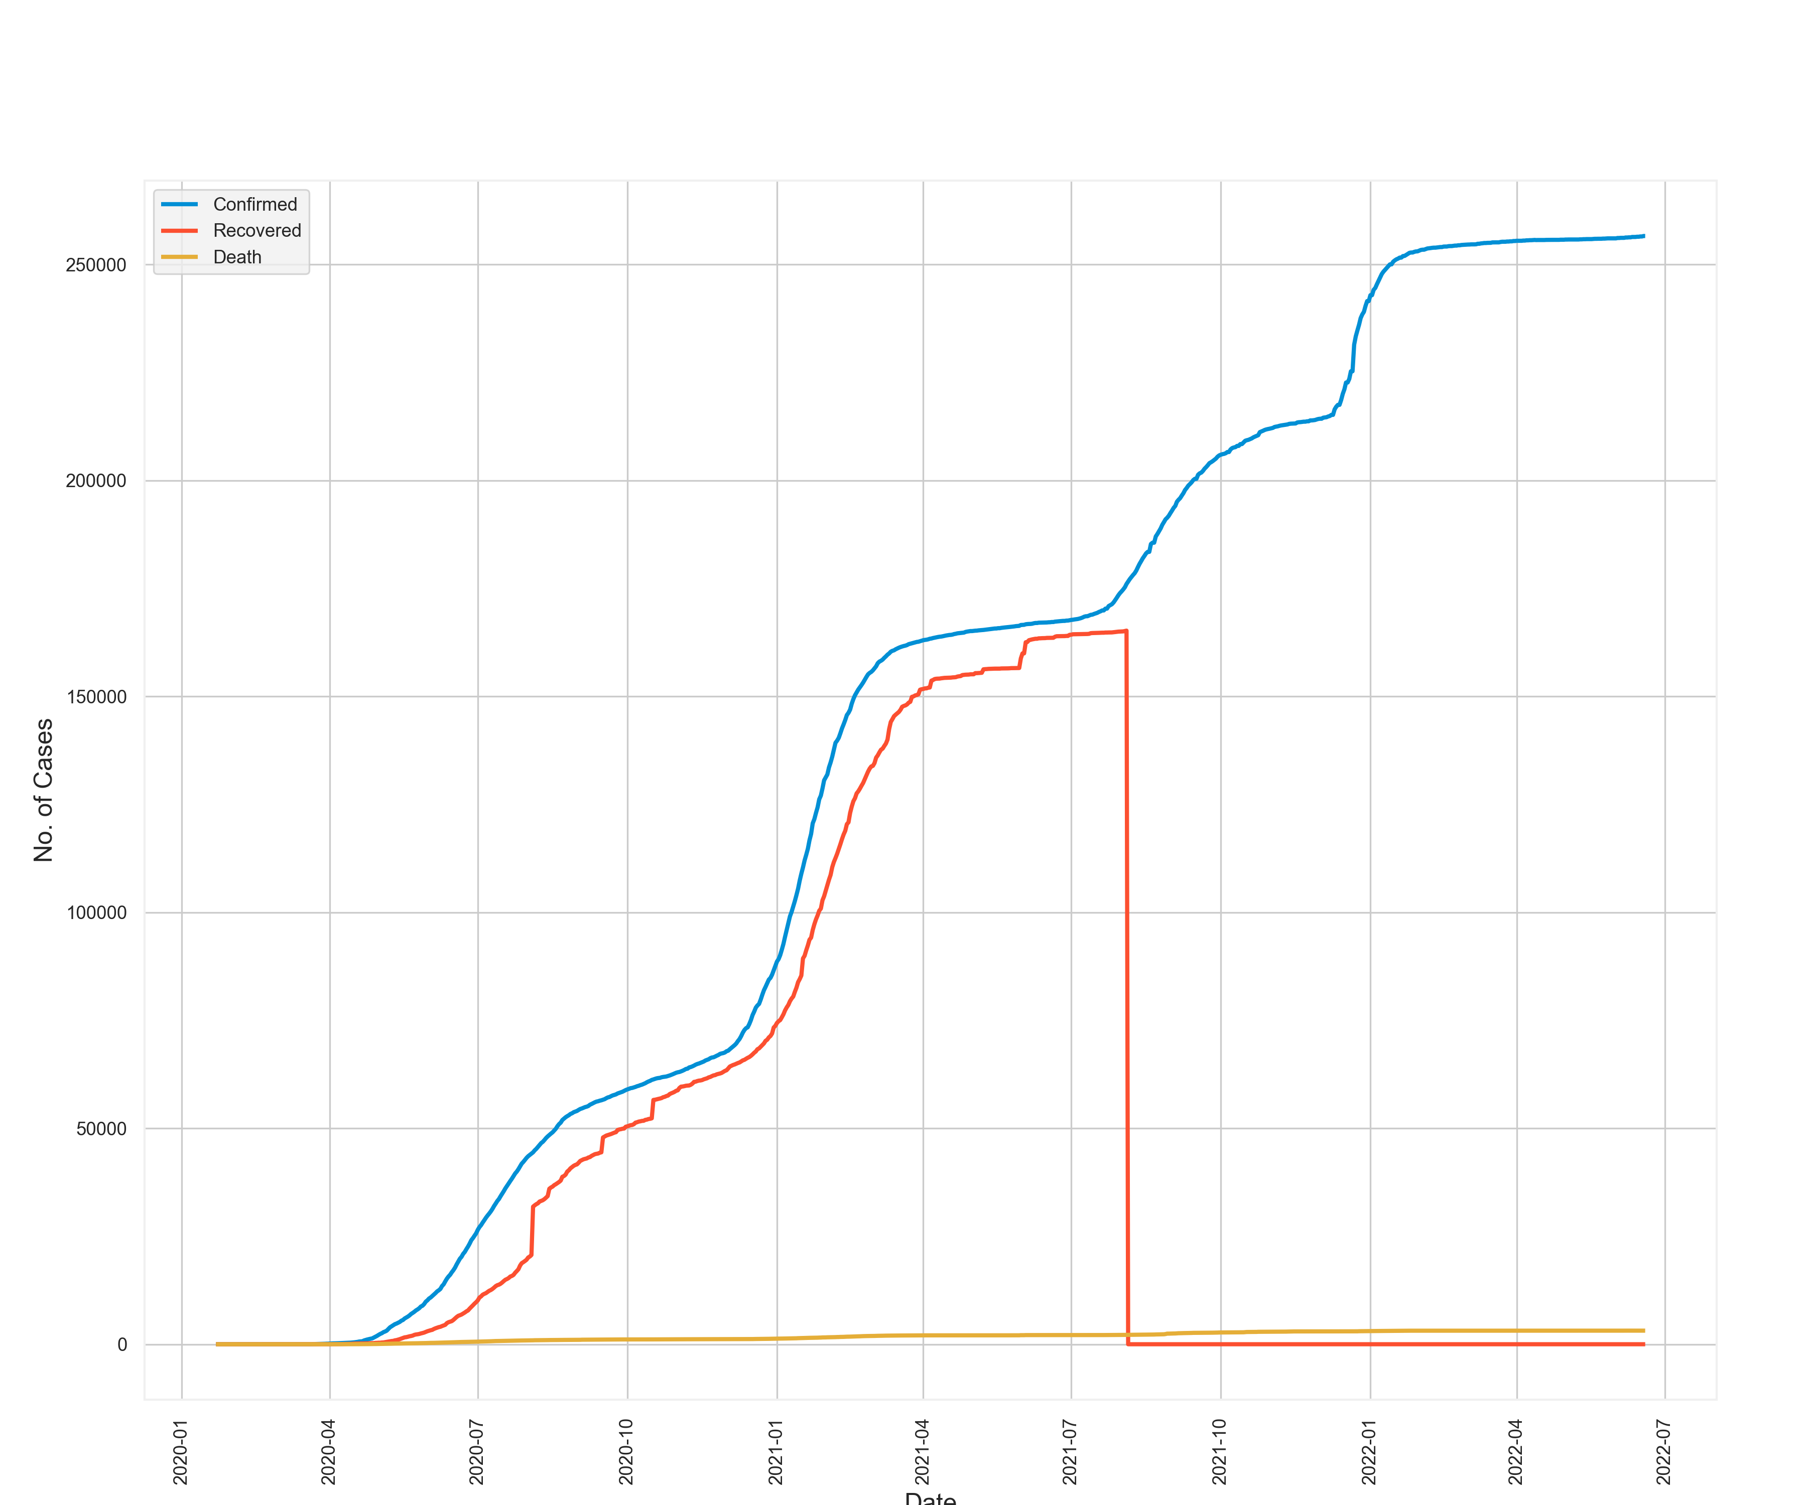
Daily Report of Confirmed, Discharged and Death Cases
This plot shows:
1. The rapid growth in the number of confirmed cases
2. The instant decline of COVID 19 recoveries between July and September, 2021
3. A slow but steady increase in the number of deaths
4. The possible relation between falling recovery numbers and rising death records

Slide 15
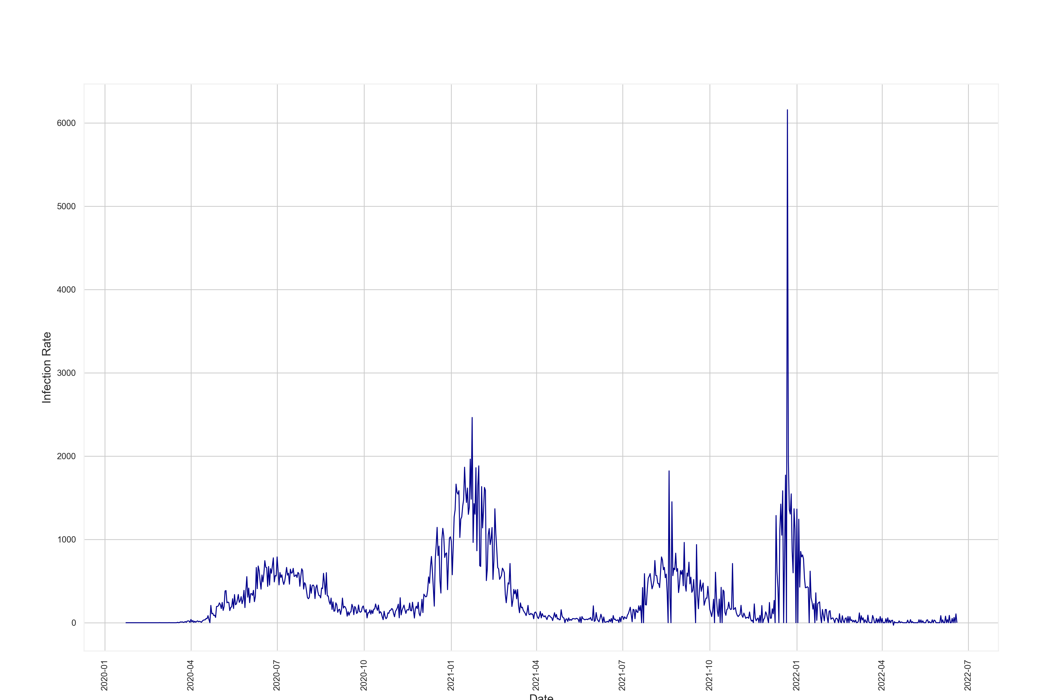
Daily Infection Rate
From this plot, we see COVID at its severest between December 2021 and January 2022

Slide 16
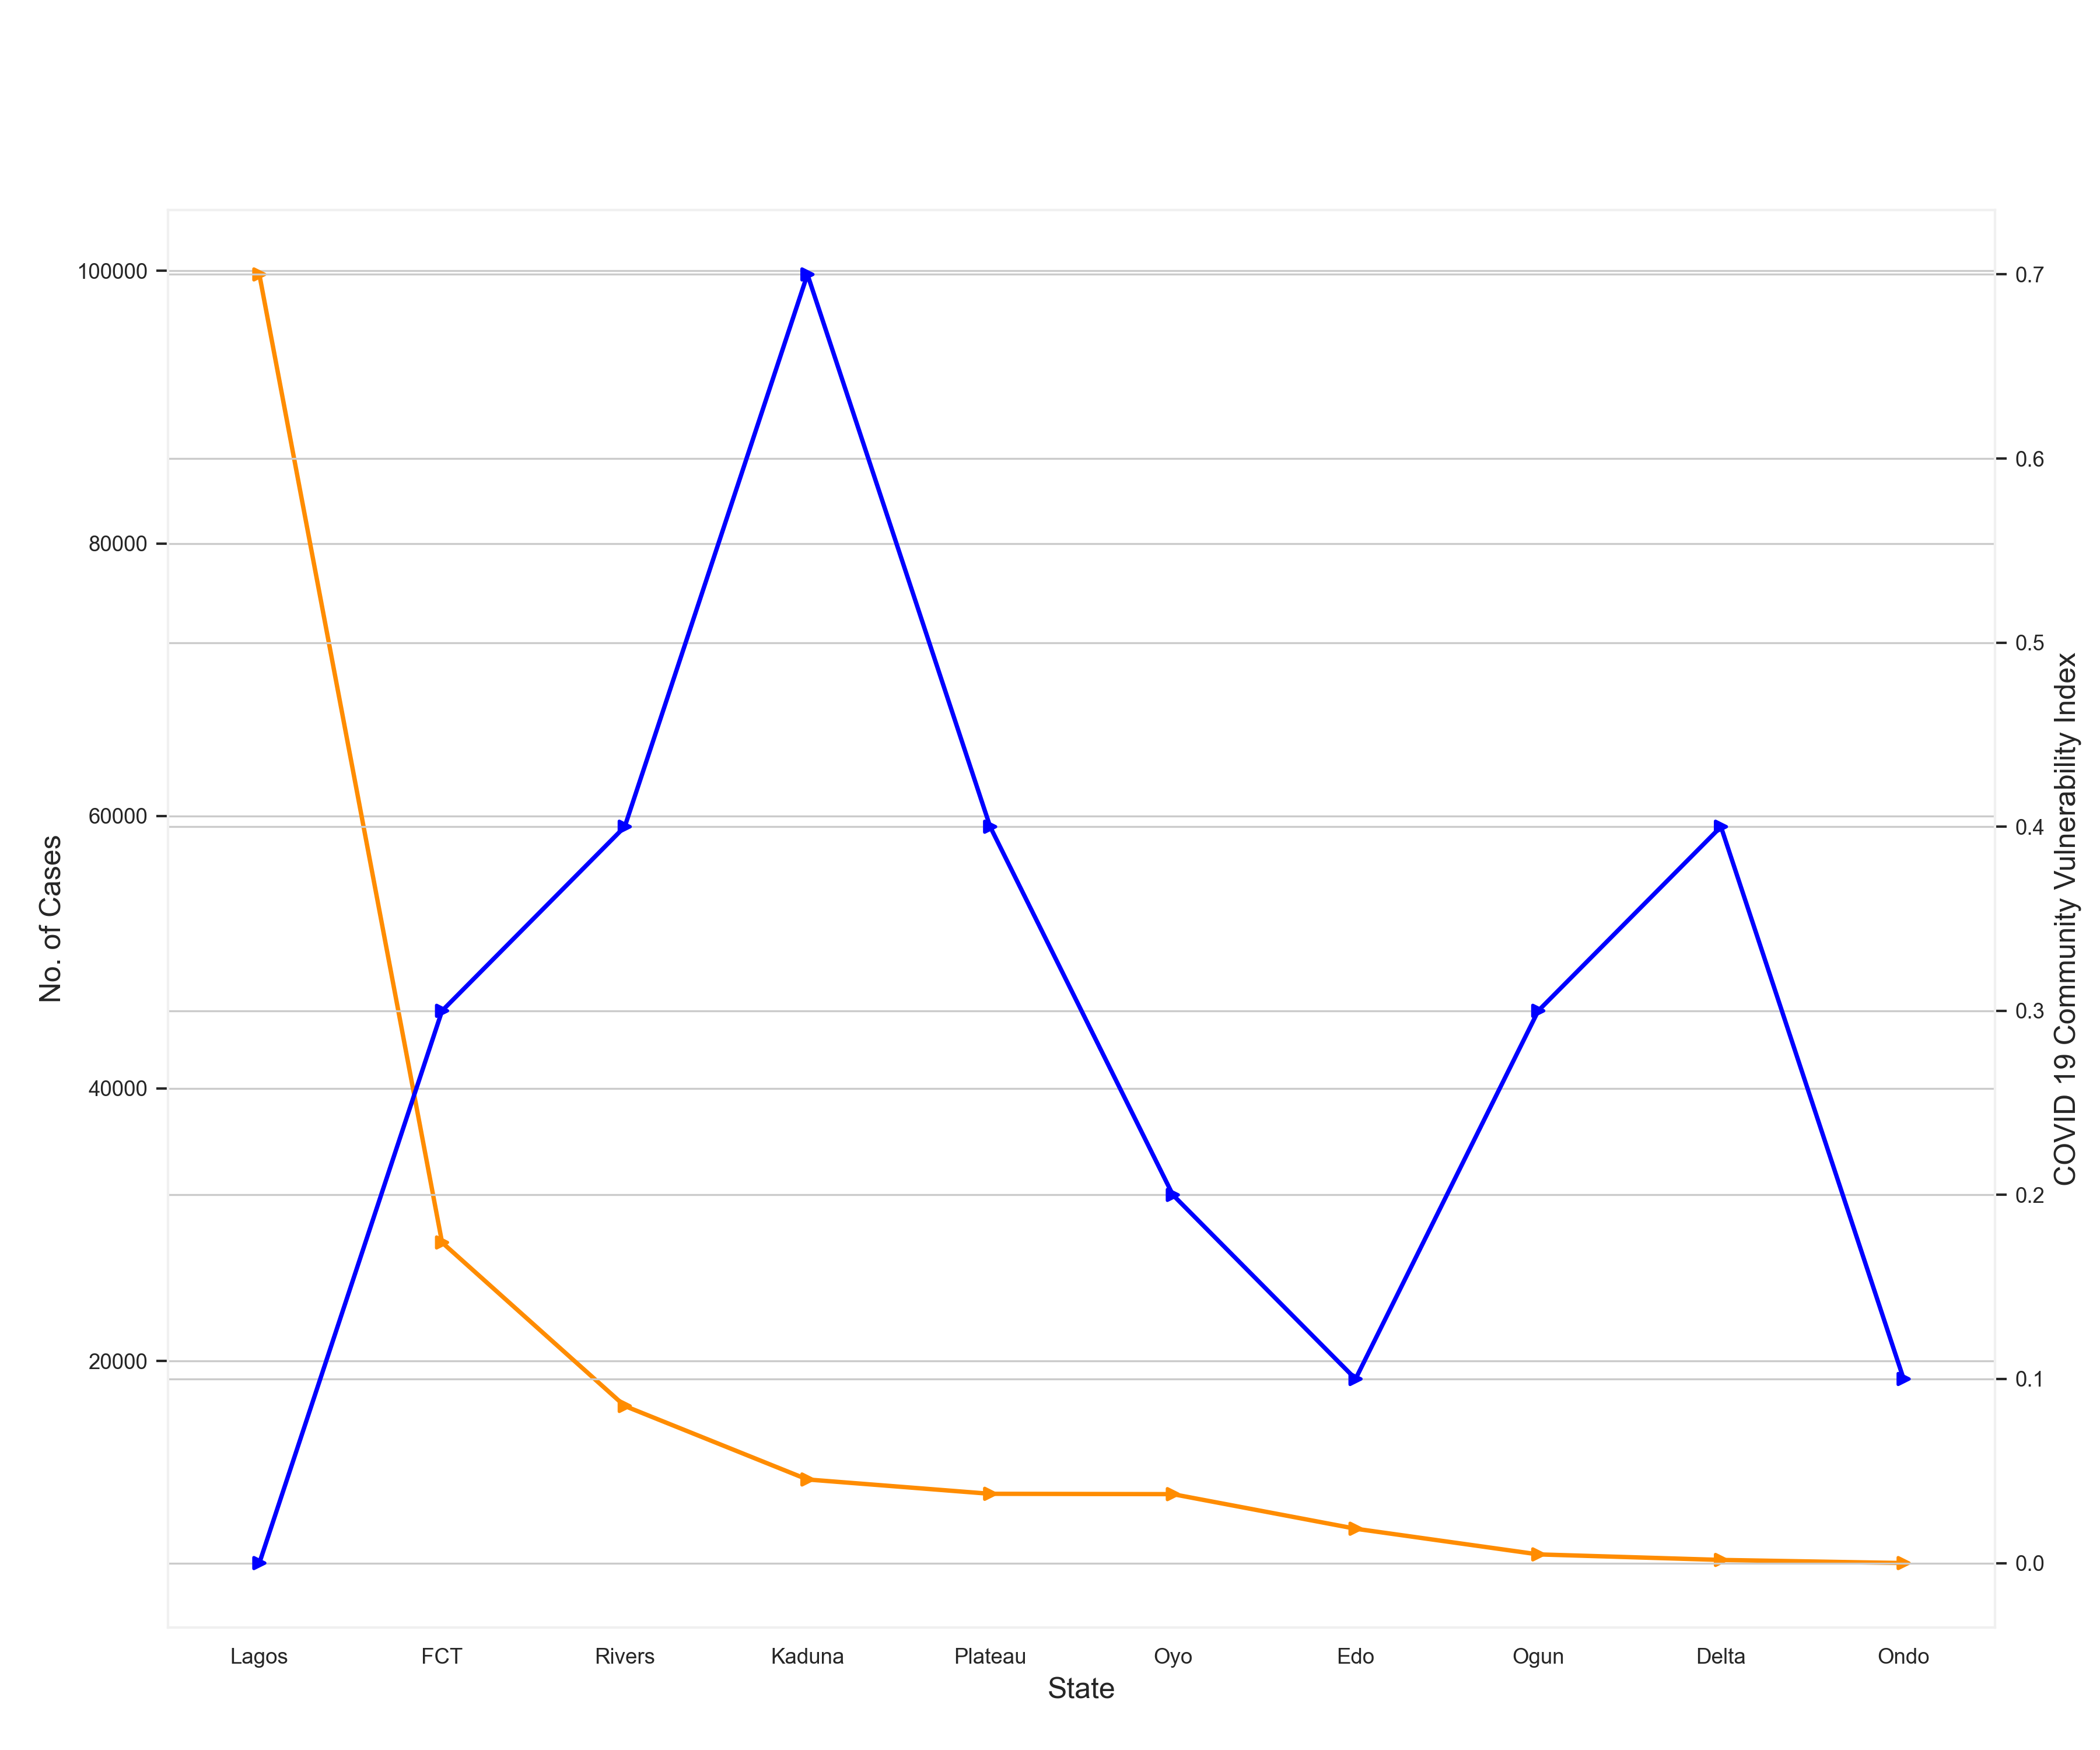
Relationship Between Confirmed Cases and Vulnerability Index
Observation: This plot shows that CCVI Index has a weak and negative correlation with confirmed cases.
In English, that means, CCVI in itself holds little information on the number of confirmed cases in a state. The correlation being negative means a high value of CCVI Index results in associates to a low value in number of confirmed cases.
Example: Lagos and Kaduna are great instances of the correlation being negative but the fact this does not occur in other states is what makes the correlation on a weak level.

Slide 17
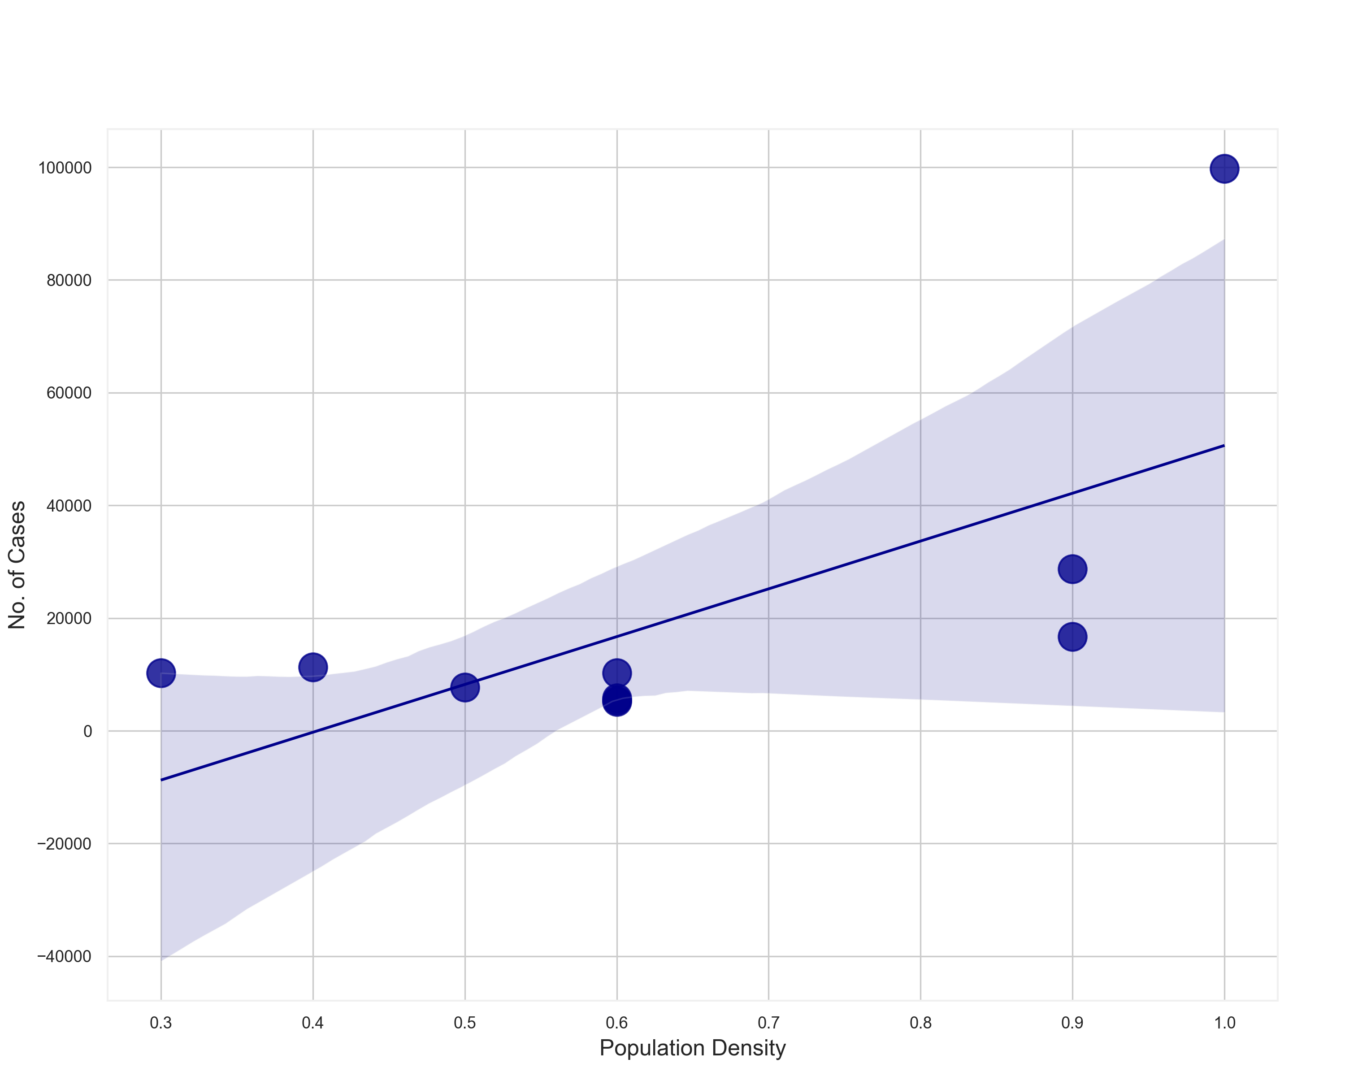
Line of Best fit for Population Density and Population
This plot shows a positive correlation between population density and confirmed cases of an area.
Studied carefully though, the 'line of best fit' that sns.regplot() returns captures perfectly only one data point.
This shows that the two features have at best a moderate correlation.
This means that a city with high population per area will fairly likely have high COVID cases.

Slide 18
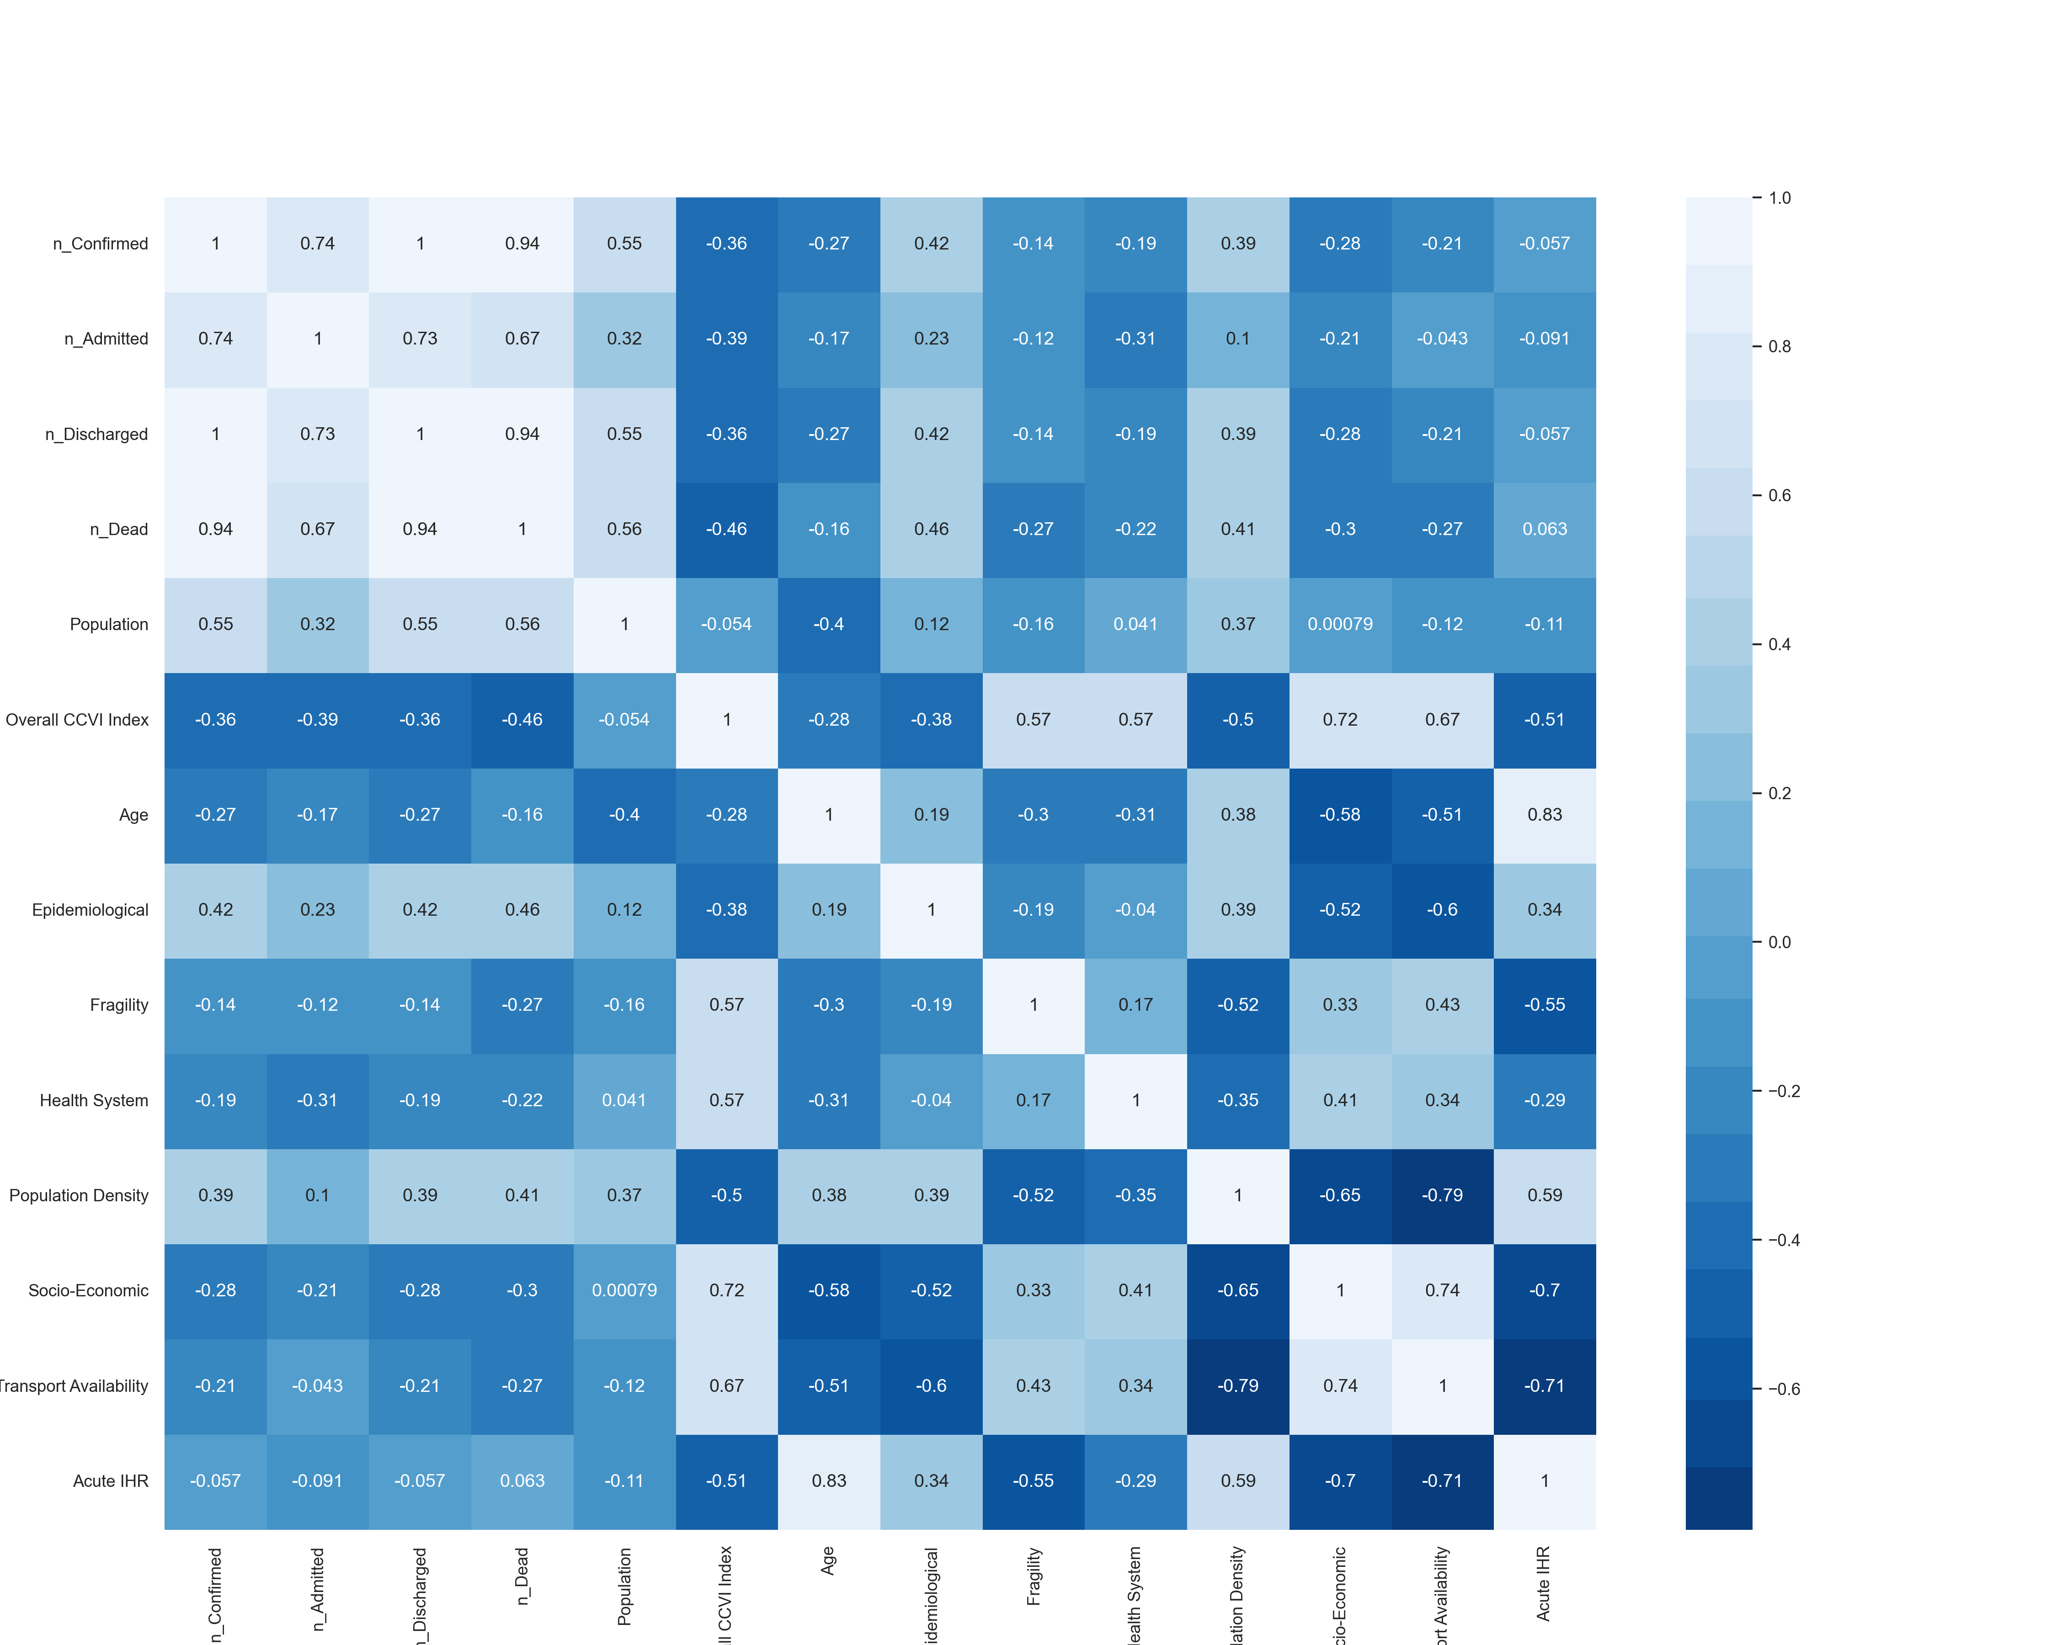
Correlation Between Numerical Features
From this plot, we can determine the correlation coefficient of every single feature with all others
Some of the correlations:
1. Age and Acute IHR (Very strong and positive)
2. COVID Vulnerability and Socio-Economic status (Very strong and positive)
3. Transport and Population Density (Very strong and negative)
4. COVID Vulnerability and Health System (Strong and positive)
5. Population and Socio-Economic status (Very weak and positive)
6. Number of Admitted Cases and Transport Availability (Very weak and negative)
7. Number of Confirmed Cases and Population (Strong and positive)

Slide 19
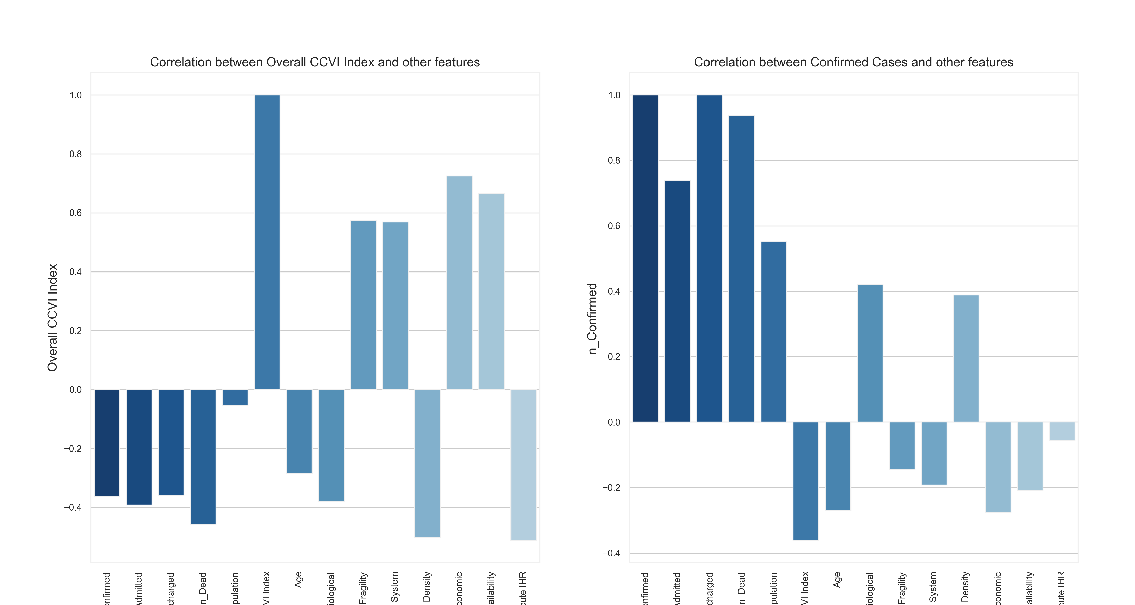
Claims made by this plot will be supported by subsequent plots

Slide 20
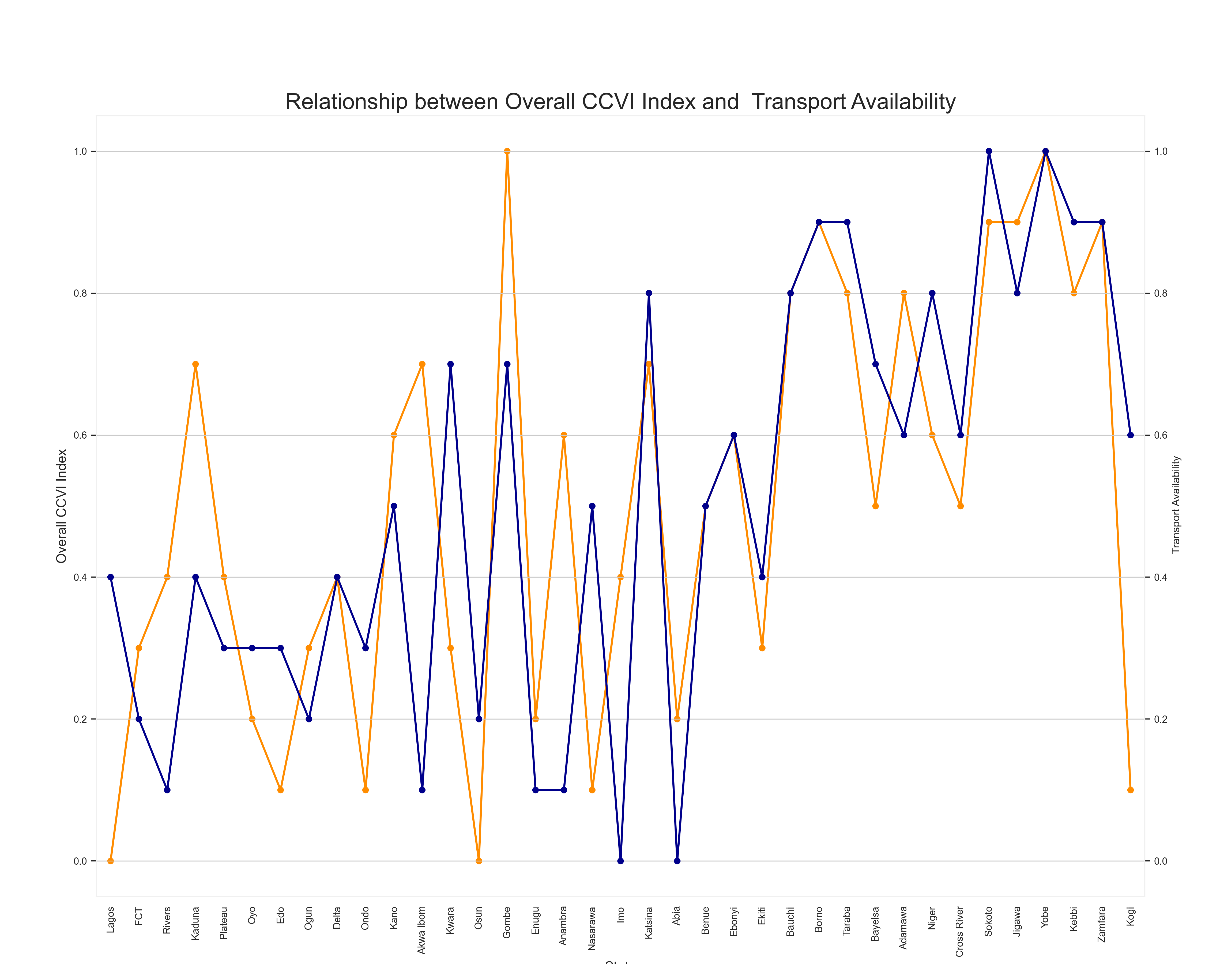
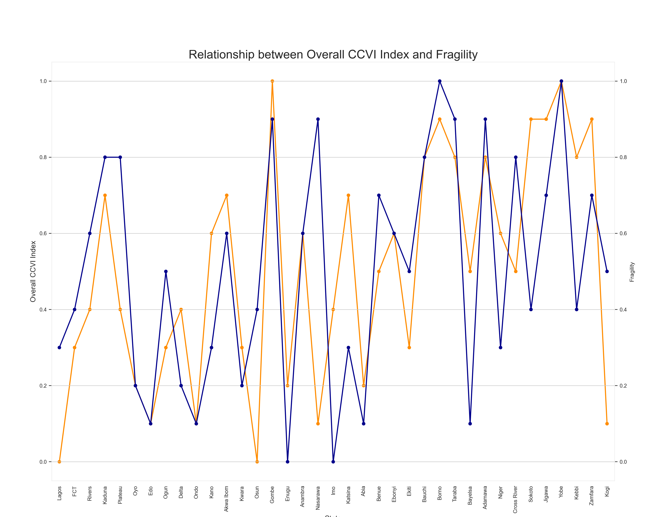
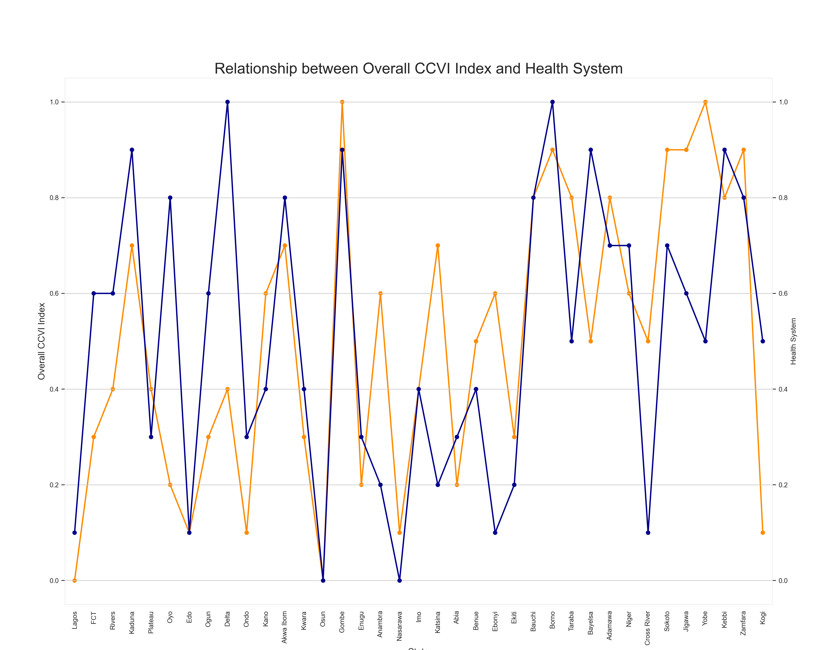
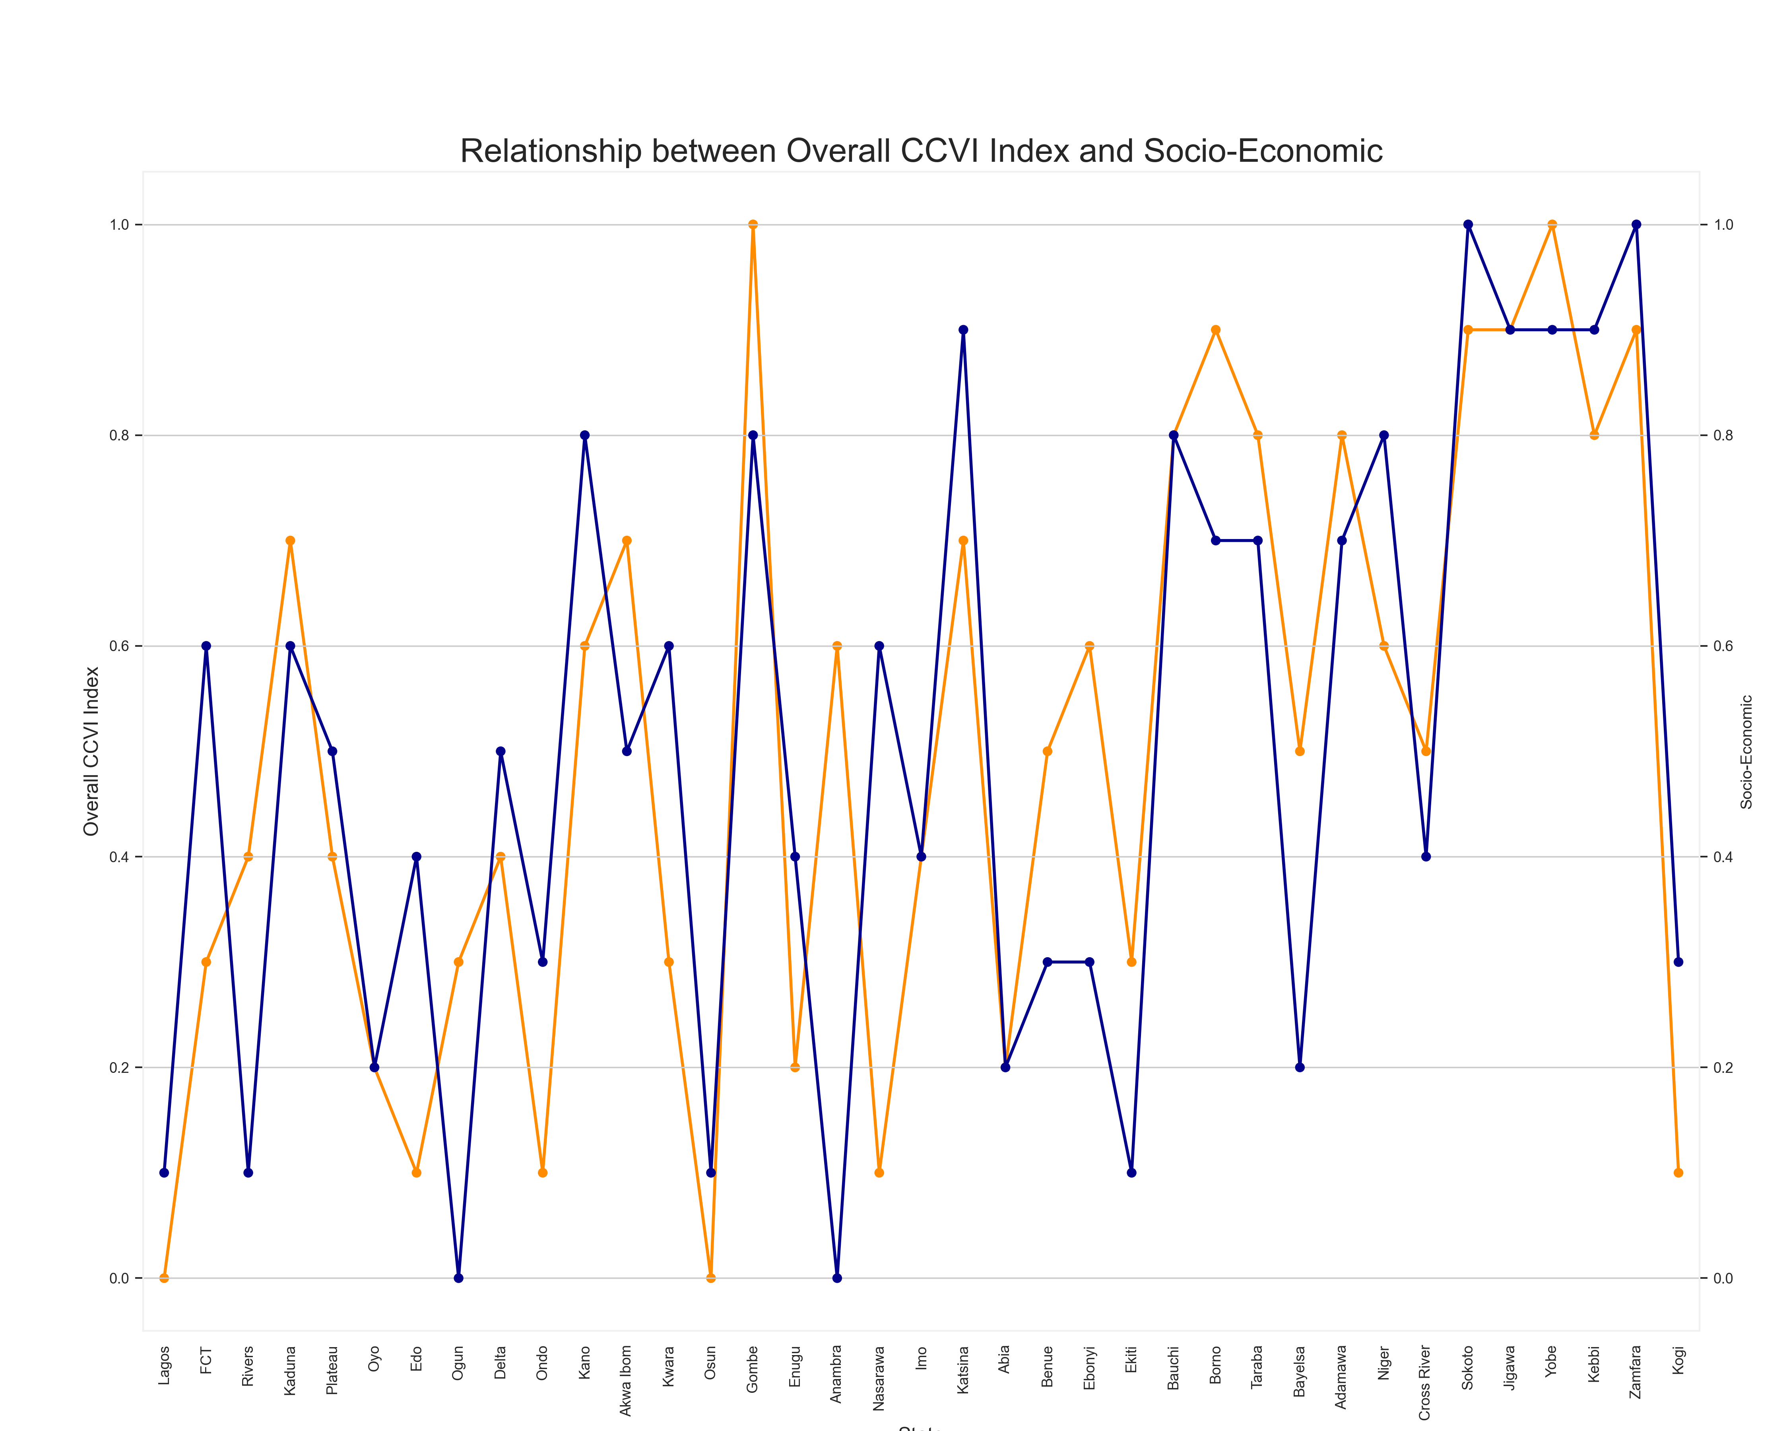
The plot points closely tracking each other show very strong correlation to Vulnerability Index.
These plots confirm the hypothesis of the previous plots.

Slide 21
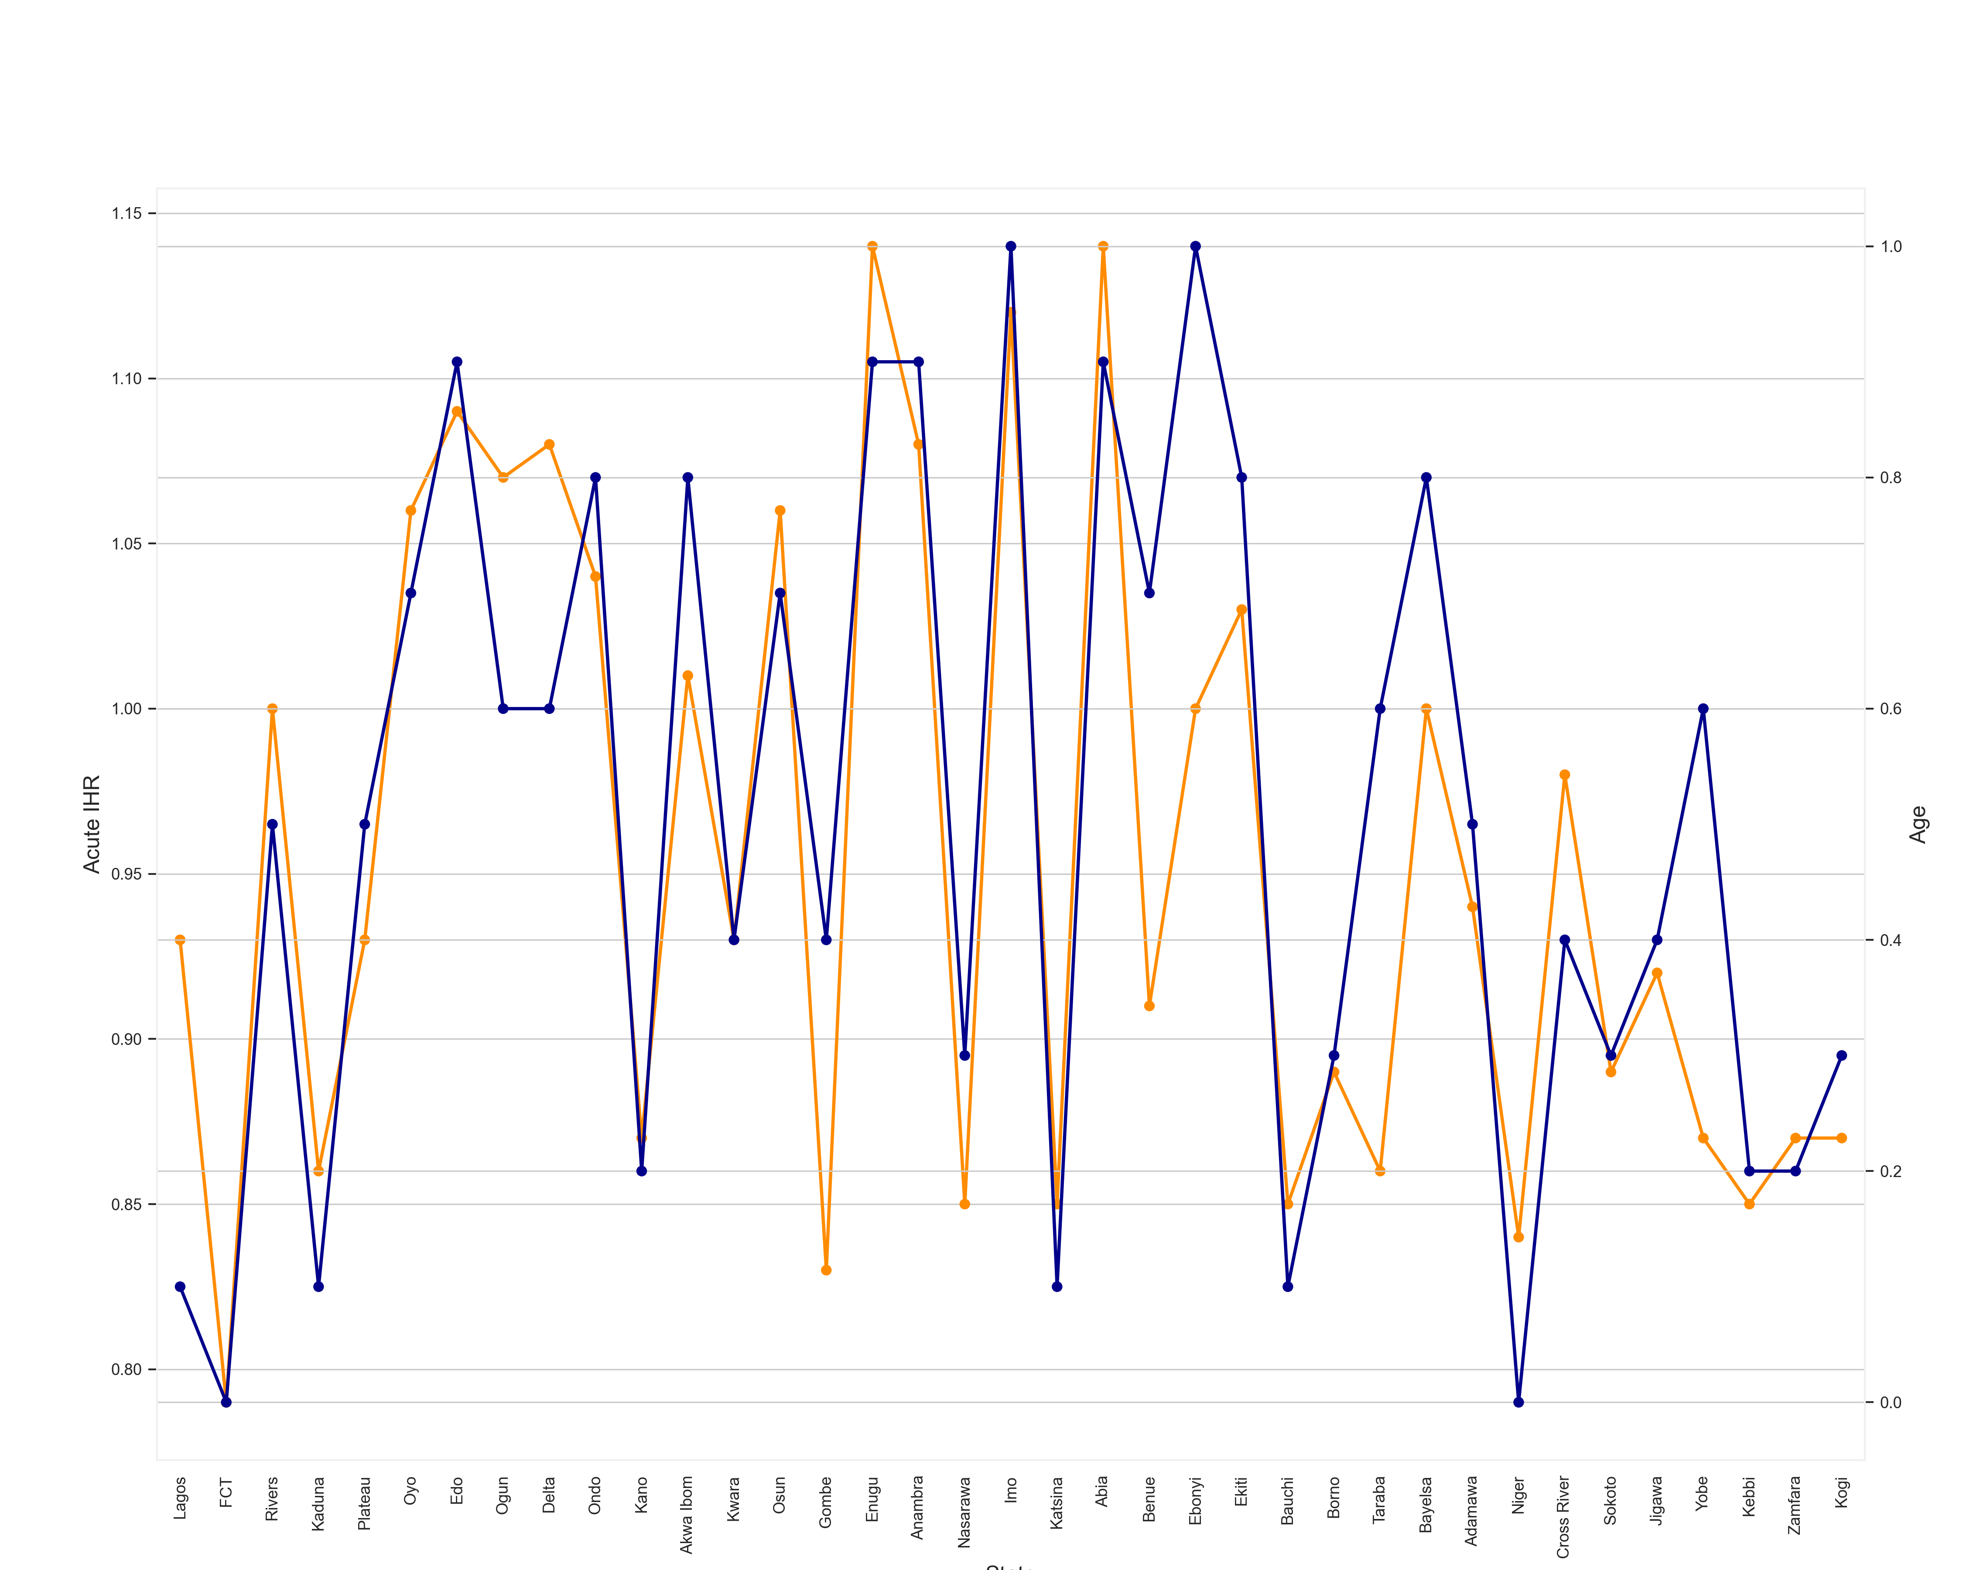
Relationship Between Age and Acute IHR
It is interesting to see the data conform strongly with the fact that the elderly in any place generally need greater health care than the youngsters.

Slide 22
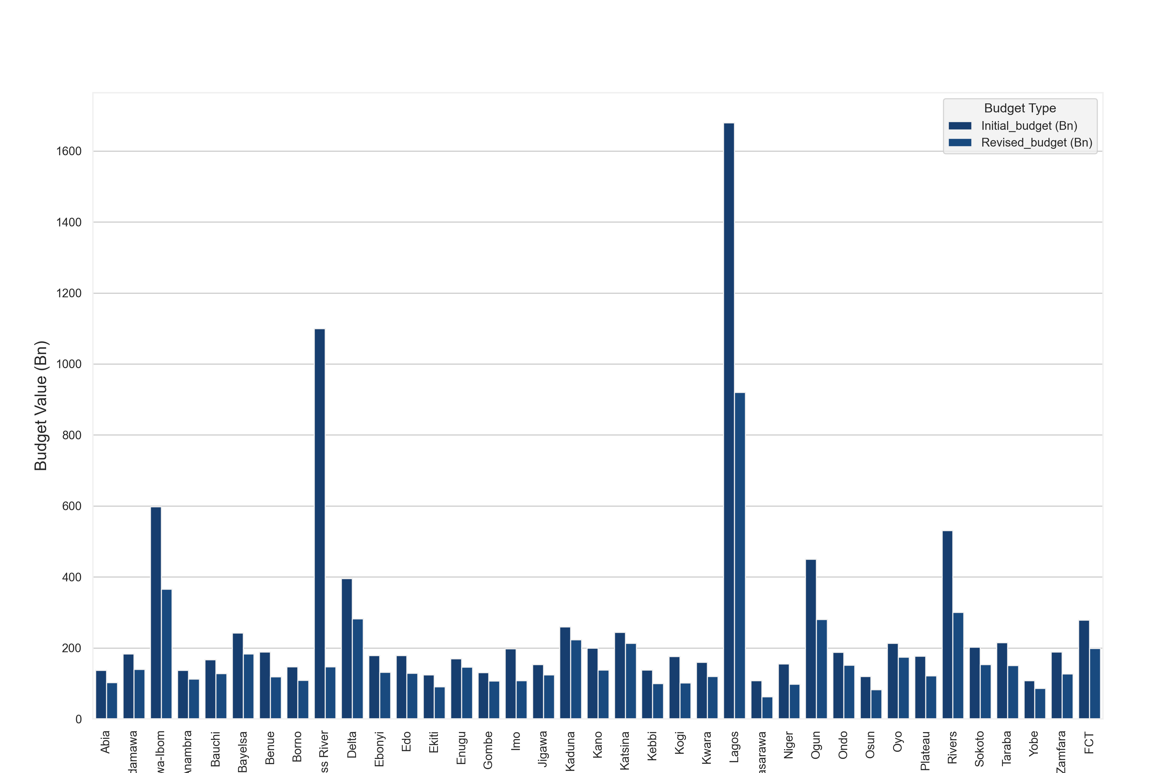
COVID-19’s Effect on States’ Budgets
This plot shows how every state has had to revise its budget and probably allocate more to mitigating the effect of COVID-19.

Slide 23
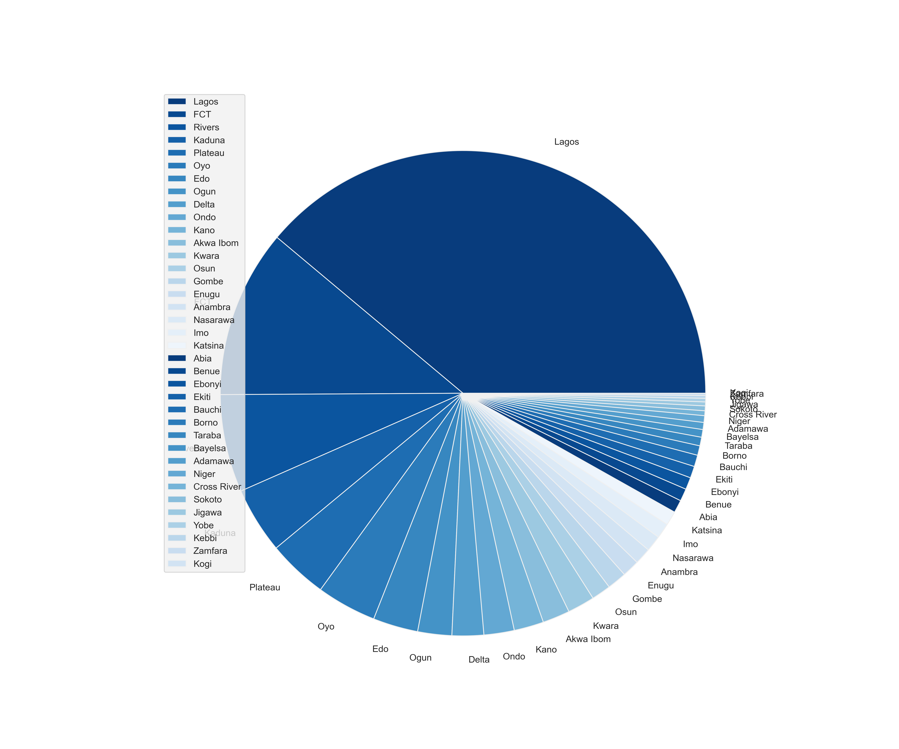
Most Affected States by Percentage
This shows that Lagos State undoubtedly saw the biggest outburst of the virus.
Followed by FCT, Rivers and Kaduna. It's no surprise that these cities are the most industrial in the country.

Slide 24
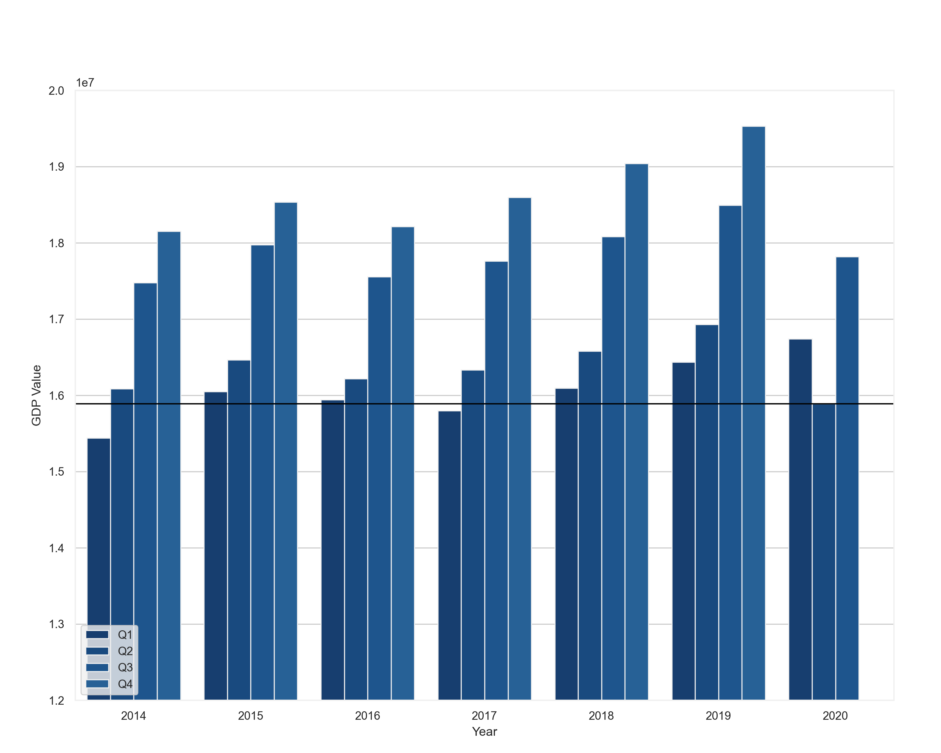
GDP for every Quarter of every year since 2014
The plot shows a general trend of rising GDP over the quarters of every year except for the year 2020.
In 2020, we see what seemed like it would be a great year given that it had the highest GDP in the last 6 years.
This GDP took a massive hit in the beginning of the second quarter when the virus was first confirmed in the country (~ April, 2020)
The second quarter GDP of 2020 is an all time low.

Slide 25
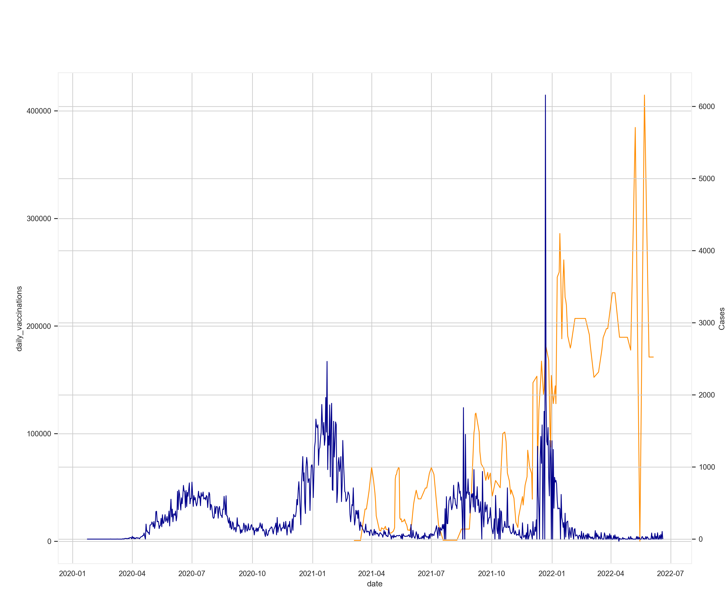
Daily Vaccinations Effect on Rate of Infection
The daily vaccinations rolled out (in orange) shows that vaccination is effective for curbing the spread of the virus.
The massive spike in vaccination caused a flattening of the curve which was the goal.

Slide 26
05
Conclusion / The Solution?

Slide 27

Vaccination
Has proven to be the solution. It has helped flatten the curve and today, COVID is practically ineffective.

Slide 28
Thanks!

Slide 29
References
https://www.aljazeera.com/news/2020/11/21/nigeria-slips-into-recession-blamed-on-covid-19-and-oil-prices
https://www.pwc.com/ng/en/assets/pdf/economic-alert-october-2020.pdf
https://slidesgo.com/theme/covid-19-vaccine-breakthrough-case-investigation-and-reporting#search-Coronavirus&position-7&results-86

